Slide 1
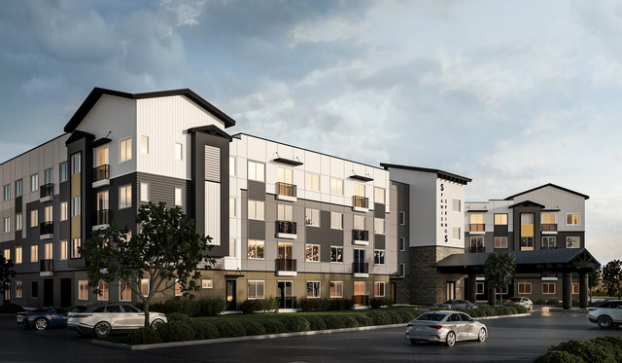
WSUP21-0025
Vintage at Spanish Springs
Board of Adjustment
November 4, 2021

Slide 2
Request
The request is for a special use permit to allow the use of Continuum of Care Facilities, Seniors, for a 257-unit continuum care rental community, in accordance with Table C-3 of the Spanish Springs Area Plan, a portion of the Washoe County Master Plan

Slide 3
Background
The development will be an independent living community for seniors
The proposed continuum of care facility will be 100% affordable to lower-income seniors (at or below 60% of the area median income)

Slide 4
Building Characteristics
The building will be 204,300 sq. ft, 4 stories tall, and will include 257 units with common areas
The main building is built around a 28,900 sq. ft outdoor courtyard, with the units and common areas surrounding the courtyard
Located on the first floor will be a central common gathering area with a piano, fireplace, large community kitchen and covered veranda also in the building will be a fitness facility, game room with billiards, an arts and crafts room with large work areas, an onsite business center and library, where residents will be able to use computers, fax, copy and print

Slide 5
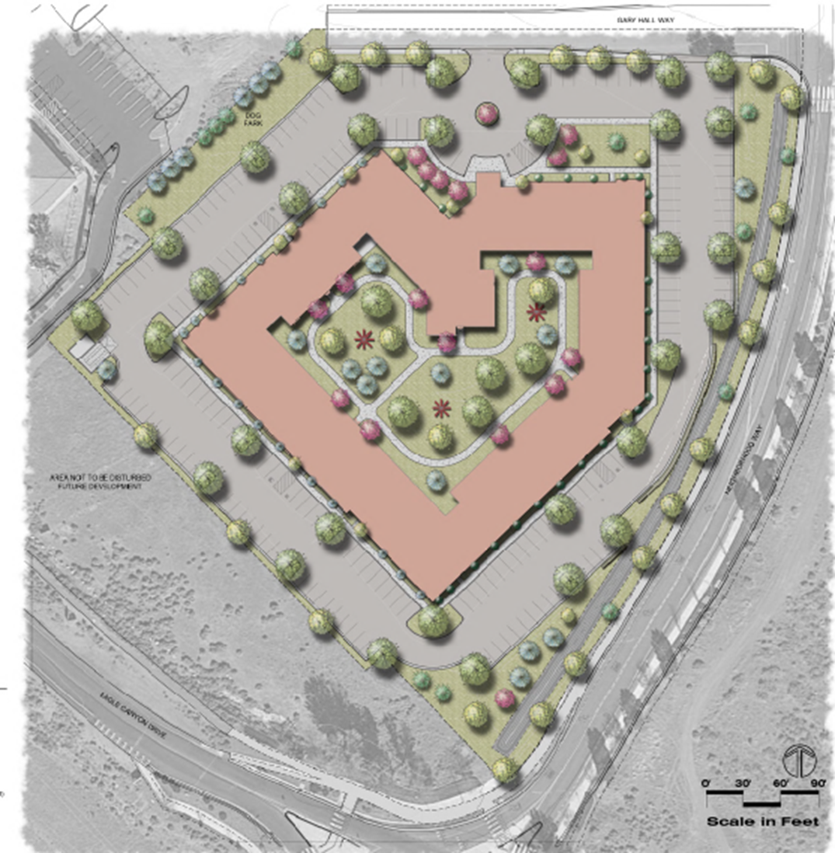

Slide 6
Building Characteristics
The 257 units will either be studios, one-bedroom or two-bedrooms units, ranging in size from 407 sf to 727 sf
The units are designed to meet the needs of seniors and those with disabilities with kitchens and baths with lower-level countertops and bathrooms will be large and fully accessible with roll in showers and grab bars

Slide 7
Building Characteristics
The rents for the units will range from $877 to $939 and will includes all utilities
Average rents in Washoe County are typically $1,500 a month and do not include utilities

Slide 8
Analysis
Continuum of Care Facilities, Seniors does not require a specific number of units or parking spaces and allows them to be determined during the special use permit process
Staff agrees, with the proposed 204 parking spaces, with 196 standard spaces and 8 ADA spaces for 257 units

Slide 9
Site Characteristics
The 2 parcel 6.69-acre site is a vacant and relatively flat parcel covered with native shrubs and grasses.
The parcels have a master plan land use designation of Commercial (C) as are the parcels to the north, west and east and the parcel to the south is designated Suburban Residential (SR)
The parcels have a regulatory zone is Neighborhood Commercial (NC) as are the parcels to the north, west and east. The parcel to the south has a regulatory zoning of Parks and Recreation (PR)

Slide 10
Site Characteristics
The site is located on the corner of Eagle Canyon, Neighborhood way and Gary Hall Wy.
To the east of the parcel is Neighborhood Way a two-lane arterial street with a center median and sidewalks on both sides.
Just Kidding Learning Center is to the northwest and Cascades of the Sierras, assisted living and memory care facility is located to the north on Neighborhood Way

Slide 11
Landscaping
The landscape plan provided with the application states 45,591 sq. ft. (20%) of the site will be landscaped and will meet Washoe County code.
The courtyard area will be landscaped with various amenities including shade pavilions, patio/seating area walking path, benches and outdoor BBQ.
A dog park is located along the northwest property line.

Slide 12
Traffic
The study states that the project will generate 1,432 average daily trips (ADT) with 88 AM peak trips and 112 PM peak trips
The study concludes that the project will have minimal impacts to the existing streets network and the network will be able to accommodate the proposed project
Typically, the driving patterns associated with the use is not anticipated to impact the traffic

Slide 13
Grading
The site is relatively flat however there will be approximately 10,200 cubic yards of fill material required to construct the project
The proposed grading is to construct the proposed building, roadways, and parking lots

Slide 14
New Conditions
The facility will provide a fully equipped emergency medical station available 24/7 near the ground floor entry for quick access to emergency medical personnel. Additionally, staff will be able to connect to 24/7 online and on call to medical professionals that can assist and advise for medical issues.
The facility will provide all residents with the option of having a 24/7 mobile monitoring devices they can carry with them while on the property.

Slide 15
Public Notice & Neighbor hood Meeting
Notices were sent to 40 parcels
A neighborhood meeting was held on October 21st at 6:30 pm at the pre-school adjacent to our site
No one attended the meeting

Slide 16
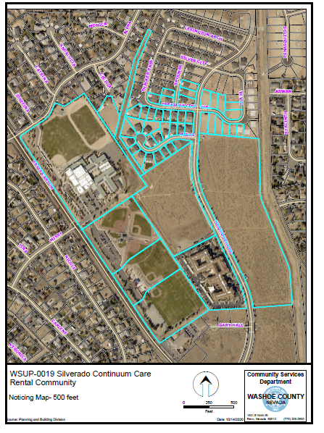

Slide 17
Reviewing Agencies
Various agencies reviewed the application, their comments are included in the staff report
Agencies with conditions, are included in the Conditions of Approval

Slide 18
Findings
Staff is able to make the findings as explained in the staff report

Slide 19
Motion
I move that, after giving reasoned consideration to the information contained in the staff report and information received during the public hearing, the Washoe County Board of Adjustment approve with conditions Special Use Permit Case Number WSUP21-0025 for Spanish Spring Associates LP, with the conditions included as Exhibit A to this matter, having made all five findings in accordance with Washoe County Code Section 110.810.30

